Slide 1
PRH REORGANIZATION

Slide 2
WELCOME AND INTRODUCTIONS
Notes:
Introduce moderator, speakers, note taker etc.
Discuss housekeeping items
How Q & A will be handled, if offered

Slide 3
Purpose and Objectives
To present the new policy organization and structure.
To provide an overview of the new PRH website.
To review the reorganization process.
Notes:
Introduce topic and review purpose and objectives
Discuss historical perspective including why the project was started
Review points on slide

Slide 4
POLICY ORGANIZATION AND STRUCTURE

Slide 5
Policy Organization & Structure
Current PRH Structure Linear Organization
Outreach and Admissions
Career Preparation Period
Career Development Period
Career Transition Period
Management
Administrative Support
Reorganized Structure
Functional Organization
Enrollment Services
Student Support Services
Student Training Services
Placement Services
Management Services
Administrative Support Services
Notes:
Explain the current layout versus the new layout
The difference between linear organization and functional organization
Linear refers to the ePRH
Functional refers to the PRH
Benefits of functional organization
Eliminates duplication and reduces the number of policy pages
Groups like tasks/policies together
Increases ease of use when looking for a specific policy topic

Slide 6
Policy Content Organization Functional (PRH) Chapters & Sections
ENROLLMENT SERVICES
Outreach & Recruitment
Eligibility
Career Guidance & Assessment
Enrollee Selection
Center Applicant File Review
Assignment & Departure
STUDENT SUPPORT SERVICES
Counseling
Community Living (Residential)
Health Services
Disabilities
Student Conduct
Evaluation of Student Progress (ESP)
STUDENT TRAINING SERVICES
Training Management
Academics
Career Technical Training
Career Success/Workplace Skills
PLACEMENT SERVICES
Eligibility for Services
Graduate Services
Former Enrollee Services
Transition Services
Program Mgmt.
Personnel
Safety & Security
Significant Incidents
Procurement
Property
Financial Mgmt.
Facility Operations & Maintenance
Environment & OSH
Food Services
Media
ADMINISTRATIVE SUPPORT SERVICES
Leaves & Absences
Enrollments, Transfers, Separations
Allowances & Allotments
Records Management
Rights
Clothing
Transportation
MANAGEMENT SERVICES
Notes:
Review the sections of the new functional PRH chapters
Point out where some policy has moved to
Example: All policy related to disabilities is now located in one chapter called Student Support Services in the Disabilities Section
Example: All policy related to records management is now located in one chapter called Administrative Support Services in the Records Management Section. Instead of having multiple locations where policy directs the reader to enter a case note, it is in one requirement in this section.

Slide 7
Results of the Reorganized PRH
Page Reduction
Easier to search for specific policy
Increases manageability of policy content
PRH Page Count Comparison
Original and New PRH | Content Pages | Exhibits Pages | Appendices Pages | Total Current Pages
Original PRH | 323 | 211 | 927 | 1461
New PRH | 274 | 164 | 564 | 1002
Total Pages Deleted | 49 | 47 | 363 | 459
Notes:
Review the slide
To review what was removed go to the maps

Slide 8
PRH WEBSITE OVERVIEW
Notes:
We will now provide an overview of the reorganized website.
Note: The Change Notice will provide the new address for the reorganized website at the time the policy is published

Slide 9
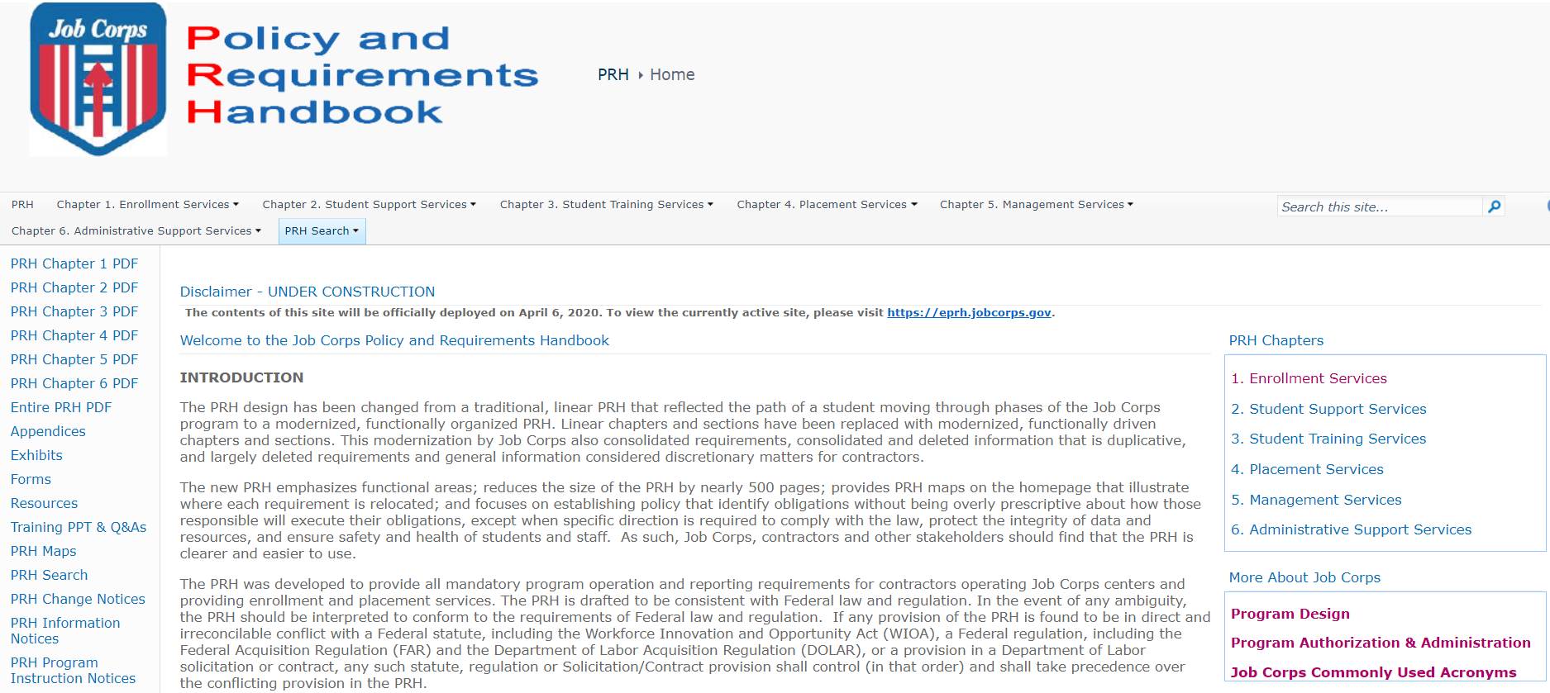
PRH Website Overview

Slide 10
PRH Website Overview
Notes:
Point out the drop down menus and new sections in slides 10, 12-16.

Slide 11
PRH Website Overview
Notes:
Describe what a portion of a new section looks like. Note that the purpose was deleted.
Review the exhibits on the right side of the page. Note that the forms, exhibits, appendices, resources

Slide 12
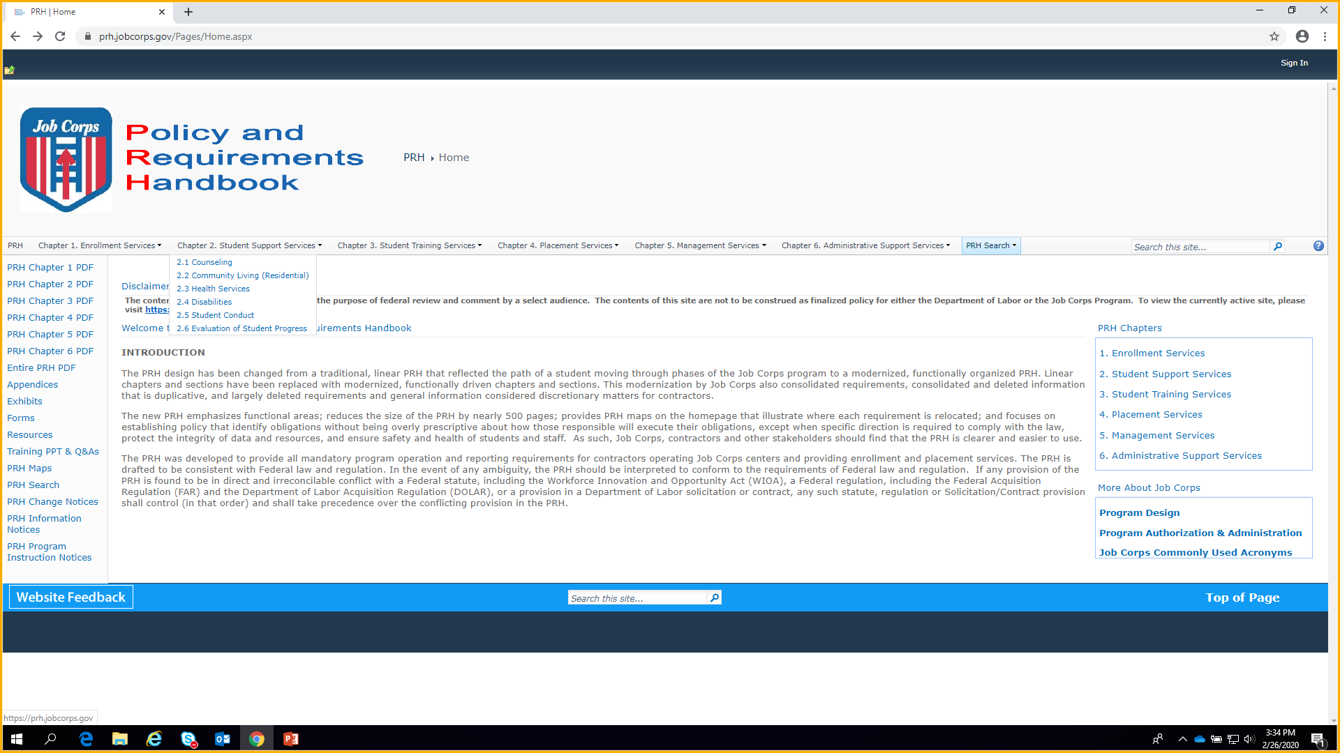
PRH Website Overview

Slide 13
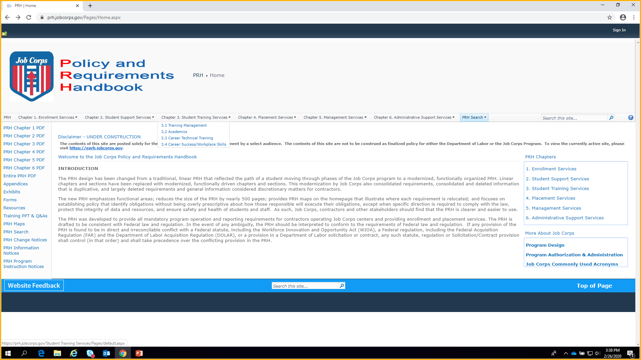
PRH Website Overview

Slide 14
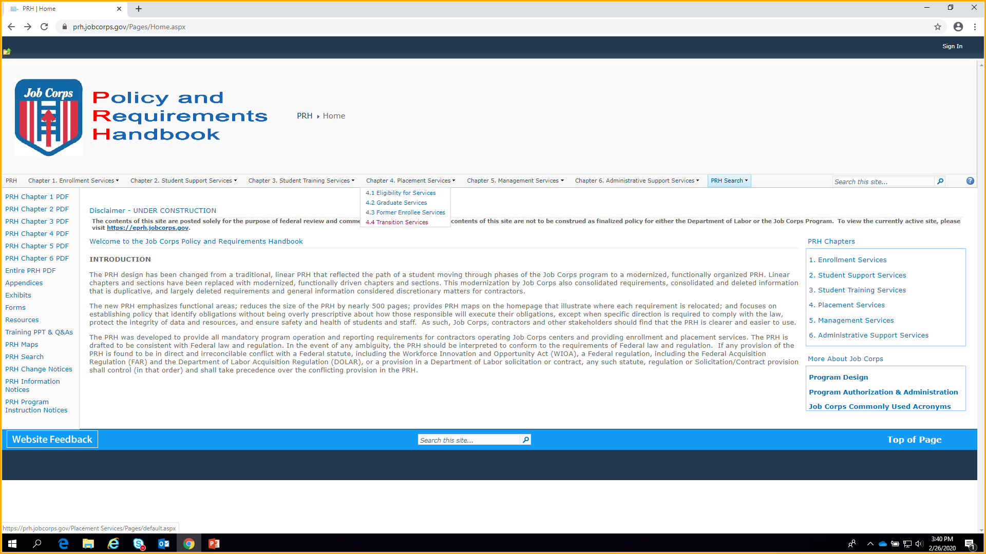
PRH Website Overview

Slide 15
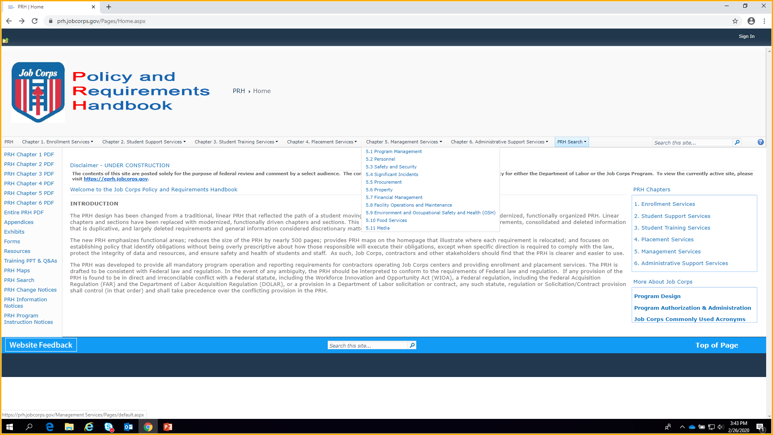
PRH Website Overview

Slide 16
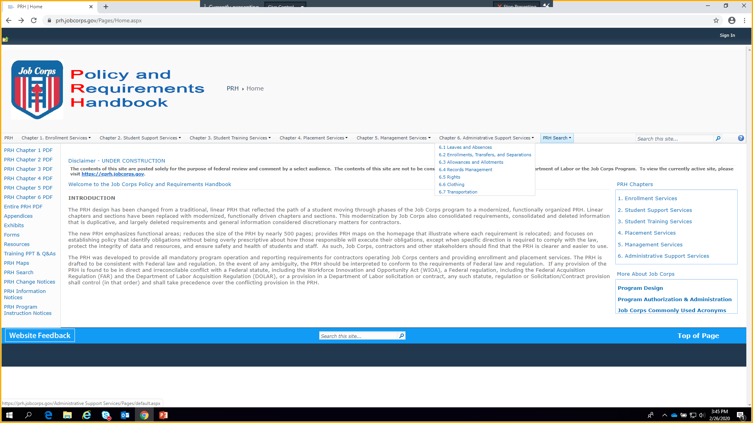
PRH Website Overview

Slide 17
PRH Website Overview
Notes:
Review appendices

Slide 18
PRH Website Overview
Notes:
Review exhibits

Slide 19
PRH Website Overview
Notes:
Review the content of the forms folder
Note that the first 2 documents are called attachments because they are part of the Appendix 501 series and are forms that can be filled out online. Rather than renaming them in the 501 series they were left as attachments
Remind audience that exhibits/appendices that contained forms or instructions for forms were renamed forms and placed in this folder.
Example: Exhibit 1-7 Job Corps Application Statement of Support can now be found as Form 1-03 in the forms folder.

Slide 20
PRH Website Overview
Notes:
Review resources
Note they are not part of the PRH policy, but resources for the user
Good place to check out periodically for new information and updates

Slide 21
PRH Website Overview

Slide 22
PRH Website Overview
Notes:
Discuss the purpose of the maps
Provide visual map of where policy moved to in the reorganized PRH
Indicate maps are named using the ePRH chapters
The next slide is an example of how policy was re-grouped in the functional format

Slide 23
PRH Website Overview

Slide 24
PRH Website Overview

Slide 25
PRH Website Overview

Slide 26
PRH Website Overview
Linear Version of the PRH - Chapter 1, Section 1.1 a - h
Functional Version of the PRH - Chapter 5, Section 5.1 R5 and R6
Notes:
Describe the movement of this requirement from Chapter 1 to Chapter 5. Point out how letter ‘h’ from Chapter 1 became its own requirement in Chapter 5. Indicate that the content of the policy was not edited. This is the case for most of the policies in the PRH.
Point out that all plans are now grouped under Section 5.1 of the reorganized PRH

Slide 27
Chapter 1 Map
Linear Version
Functional Version
Chapter
Section
Requirement
Notes:
Review title “Chapter 1 Map” is based on the ePRH
Review the Key
Review column 1, the ePRH Chapter, Section, Requirement locations
Review row 1, the title of the realigned functional chapters
Review rows 2 and 3, each PRH chapter and section
Point out examples and show where they moved ‘R’

Slide 28
Chapter 1 Map
Notes:
Review the exhibits and appendices
Exhibits, appendices and forms are associated with chapters, not sections

Slide 29
Chapter 5 Map
Chapter
Section
Split

Slide 30
REORGANIZATION PROCESS

Slide 31
PRH Policy Review
The “What” - Policy defining what services must be delivered by contractors was retained.
The “How” - Direction explaining how to deliver services was largely removed.
REQUIREMENTS
R1. Conflict Resolution Skills
Centers must provide each new student with instruction in basic conflict resolution techniques within the first 60 days of enrollment. At a minimum, instruction must include:
a. Content:
1. Defining conflict and recognizing when it exists
2. Developing strategies for dealing with conflict
Identifying resources available to help resolve conflict
Opportunities to learn and practice conflict resolution techniques
c. Explanation of the importance of conflict resolution skills in Job Corps and in the workplace
S A M P L E
Notes:
Describe the approach used to reorganize policy
Looked at the ‘What’. What do contractors have to do
Looked at the ‘How’. Removed directions explaining how to deliver services

Slide 32
PRH Policy Review
Direction given to National or Regional Offices was removed, unless it was needed to clarify the contractor’s role in the process. (SOPs will be created to drive National and Regional policy).
REQUIREMENTS
R3. Vacant or Closed Center Facilities
a. The Job Corps National Director will be responsible for protecting and maintaining a center when it is closed, in accordance with GSA requirements.
b. The center is responsible for protecting a building or structure that is vacant or closed on an otherwise active Job Corps center.
c. The demolition of inactive center facilities will be accomplished in accordance with PRH Chapter 5, Section 5.8 R6, Project Implementation and Demolition​.
S A M P L E
Notes:
Discuss how direction given to the National and Regional Offices was removed
Focused the policy on what contractors have to do
Review example

Slide 33
Benefits of the Reorganized PRH
Increased flexibility for contractors to deliver services
Reduced “how to” content to allow for customization of services
ePRH Chapter 3, Career Development Period, Section 3.7 Career Success Standards
R2. Strategies for Delivery
Centers must adopt strategies that provide diverse opportunities for each student to learn, practice, and develop competencies to meet all eight Career Success Standards via:
Integration of the standards into all phases of the program and all departments on center, including MyPACE career pathway preparation activities
Integration of the standards into formal academic and career technical skills instruction
Individual and group lessons or project assignments, held during and after the training day and on weekends, to help students master competencies in all standards
Clearly established performance levels (correlated to the Evaluation of Student Progress) for competencies, tasks, assigned projects, and/or activities
Addressing the needs of students who have difficulty progressing by addressing and documenting these in the student evaluations and Center Information System (CIS) Case Notes
Methods for evaluating the effectiveness of the design and delivery of the Career Success Standards that are in place
Centers must not establish a stand-alone class to teach to the standards. The standards must be integrated into all training and center activities.

Slide 34
Benefits of the Reorganized PRH
Minimal policy duplication
The functional format combines similar requirements into a single policy statement
For example, requirements to enter case notes were found in multiple sections throughout the PRH. Sections 3.8 R7, 3.12 R4, 3.14 R4, 3.17 R2, 3.18 R5.b, 3.19 R4, and 3.20 R4 are now combined under a single requirement.
PRH Chapter 6, Section 6.4 R11. General Reporting/Documentation/Recordkeeping in CIS
Centers must document and record in CIS, all student:
a. Concurrent Training progress (Approved alternate and additional forms of documentation must be included in the student’s permanent records upon separation.)
b. Work-Based Learning (WBL) assignment and progress (WBL Module)
c. Leadership training/student government participation
d. Driver’s education progress and test results
e. Provision for water safety instruction and swimming proficiency
f. Wellness training progress and accomplishments
g. English Language Learner (ELL)/Limited English Proficiency (LEP) test results and progress in the student’s Personal Career Development Plan and other applicable modules of CIS
Notes:
Review the slide

Slide 35
DEPLOYMENT

Slide 36
Change Notice 19-12
The Majority of the PRH Content Changes are Non-Policy Related Updates, Editorial Changes, and Clarifications
Executed and edited minor policy changes
Formatting
Realignment of Requirements
Combining of Similar Requirements
The new PRH will emphasize functional areas
There will be 6 Policy Related Changes that will be detailed in the Change Notice
Deployment Date: April 6, 2020

Slide 37
POST DEPLOYMENT

Slide 38
Post Deployment Activities Phase 2
Review Policy
A minimum of two formal policy reviews yearly and other policy reviews as needed
Continue to review and remove non-policy items

Slide 39
QUESTIONS AND ANSWERS

